Slide 1
Customer Experience Analysis of Luxury Watch Brand Stores
A Focus on Customer Satisfaction & Improvement Opportunities
Presented By:
Pankaj Padekar
Date:
29/10/2024

Slide 2
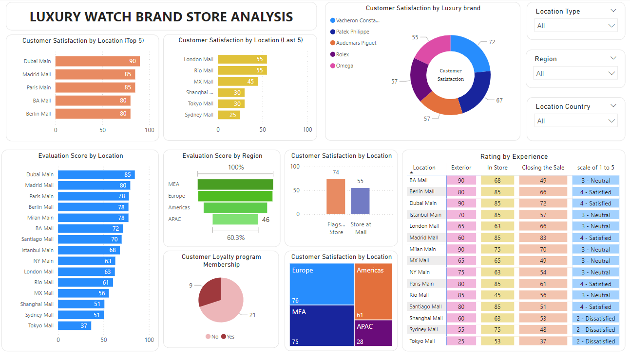

Slide 3
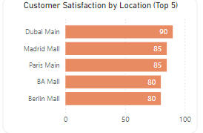
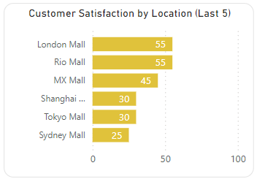
Key Insights:
Top 5 Customer Satisfaction Location:
Dubai Main Store: 90 - Highest satisfaction, indicating strong customer experiences and engagement.
Madrid Mall: 85 - High levels of satisfaction, suggesting effective service and product offerings.
Paris Main Store: 85 - Positive feedback, reflecting brand prestige and customer loyalty.
Buenos Aires (BA) Mall: 80 - Solid satisfaction levels, possibly due to personalized service.
Berlin Store: 80 - Good customer feedback, indicating strong performance in meeting customer expectations.
Bottom 5 Customer Satisfaction Location:
Sydney Mall: 25 - Lowest satisfaction, highlighting potential areas for improvement in service and product offerings.
Tokyo Store: Low satisfaction, suggesting a disconnect between customer expectations and actual experience.
Shanghai Store: Poor feedback, indicating the need for immediate changes to enhance customer experience.
Rio de Janeiro (MX) Store: Below-average satisfaction, pointing to possible service or product issues.
London Store: Low scores, suggesting the need for a strategic review of customer engagement strategies.

Slide 4
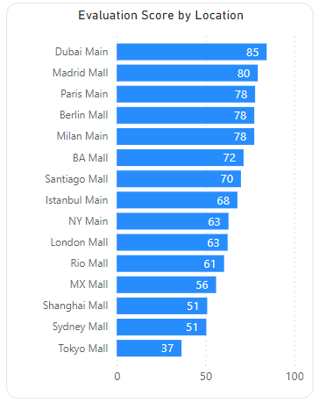
Evaluation Overview:
Key Points:
Score Range: The scores average range from 30 to 85, indicating variability in store performance.
High Performers: Highlight stores with scores above 80 as top-performing. As we can see Dubai has highest evaluation score followed by Madrid mall and Paris main store.
Low Performers: Identify stores with scores below 50 as areas needing improvement. Tokyo Mall has the lowest evaluation score. Sydney mall and Shanghai mall got average evaluation score.
What Top 5 Stores Are Doing Well:
Customer Service Excellence: Stores with high evaluation scores likely excel in personalized customer service, meeting and exceeding customer expectations.
Quality Assurance: High-scoring stores might be consistent in delivering premium product quality and ensuring a luxury experience.
Efficient Operations: These stores could have well-organized management and seamless in-store experiences, leading to higher customer satisfaction.
Improvement Strategies for Low-Rating Stores:
Focus on Staff Training: Enhance staff skills to improve communication and customer service interactions.
Feedback Mechanism: Establish channels to gather customer feedback and address concerns promptly.
Store Layout & Ambience: Review store layout, ambiance, and product displays to provide a more immersive luxury shopping experience.

Slide 5
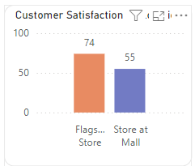
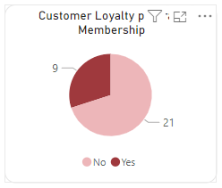
Customer Satisfaction and Loyalty Program:
Customer Preference for Flagship Stores:
Higher Satisfaction Levels: 74% of customers are happy with the Brand flagship store, compared to only 55% at authorized mall stores.
Enhanced Experience: Flagship stores offer a premium shopping experience and exclusive product collections, driving a higher satisfaction rate.
Personalized Service: Experienced staff at flagship stores likely provide more personalized attention, contributing to the higher satisfaction rate.
Loyalty Membership Preferences:
Membership Trends: Out of 30 stores, 9 stores customers do not prefer loyalty program membership, while customers at the remaining 21 stores have opted in.
Value-Added Benefits: Offer exclusive discounts, early access to new collections, and personalized services to encourage loyalty program sign-ups.
Seamless Enrollment: Simplify the membership registration process both online and in-store, and communicate the benefits clearly to customers.
Exterior Advertising: Display loyalty membership ads at the exterior of stores to capture the attention of passersby and highlight membership benefits to all potential customers.
Targeted Promotions: Focus on creating marketing campaigns to communicate the benefits of membership to customers in stores with low membership adoption.

Slide 6
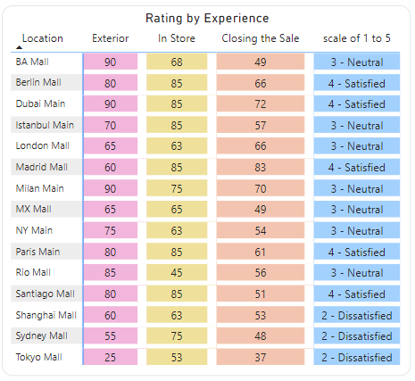
Overall Store Experience:
Customer Ratings Overview:
Exterior Experience: Highest rating of 90/100 for some stores versus a low of 25 indicates a significant gap in the appeal of store exteriors.
In-Store Experience: High rating of 85 compared to a low of 45 shows a disparity in the ambiance, service, and organization inside stores.
Closing the Sale: Madrid Mall leads with a closing rating of 83, while Tokyo has the lowest at 37.
Overall Customer Rating: Out of 5, some customers are neutral with a rating of 3, satisfied with 4, and dissatisfied with 2.
Recommendations for Improvement:
Enhancing Store Exterior:
Visual Appeal & Branding: Update store exteriors with attractive signage, well-lit entrances, and brand-consistent design to create a luxury feel.
Loyalty Membership Ads: Promote loyalty benefits by displaying visually appealing ads on store exteriors to attract attention and encourage membership.
Improving In-Store Experience:
Staff Training: Focus on staff training to enhance communication skills and product knowledge, fostering a positive and personalized customer experience.
Store Layout & Ambiance: Refine store layouts to improve flow and customer navigation while enhancing ambiance with appropriate lighting and displays.
Boosting Closing the Sale Rating:
Sales Techniques: Train staff in effective sales techniques to better guide customers through the purchase process and address any concerns.
Personalized Offers: Provide tailored discounts or incentives at the point of sale to encourage conversion and enhance customer satisfaction.

Slide 7
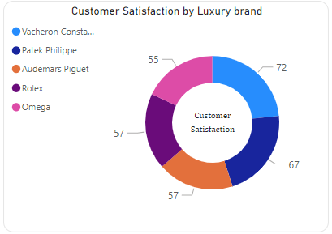
Luxury watch Brands overview:
Brand Satisfaction Overview:
Top Performer: Customers are most satisfied with Vacheron Constantin with a rating of 72. This brand's focus on luxury and attention to detail likely contributes to its high satisfaction.
Strong Runner-Up: Patek Philippe follows with a satisfaction rating of 67, indicating solid brand prestige and consistent customer experience.
Middle Tier: Audemars Piguet and Rolex both have satisfaction ratings of 55, suggesting areas where these brands may improve to better meet customer expectations.
Lowest Satisfaction: Omega holds the lowest satisfaction rating among these brands at 55, indicating potential gaps in the customer experience or product offerings.
Actionable Insights:
Leverage Strengths: Vacheron Constantin and Patek Philippe should continue leveraging their strengths in luxury perception, personalized service, and product quality.
Focus on Consistency: Audemars Piguet and Rolex may benefit from focusing on consistency in service, brand engagement, and refining their customer experience strategies.
Omega’s Improvement Areas: Omega should conduct in-depth customer feedback analysis to understand the key pain points and prioritize improvements in service quality and product offerings.

Slide 8
Areas Where the Store Exceeded Expectations:
Outstanding Customer Service:
Staff demonstrated impressive product knowledge and provided personalized assistance, making customers feel valued.
Extensive Product Selection:
The store featured a wide range of rare and exclusive watches, with an organized layout enhancing the browsing experience.
Luxurious In-Store Atmosphere:
Elegant ambiance with excellent lighting and well-maintained displays created a premium shopping environment.
Efficient After-Sales Service:
Prompt support and clear explanations of warranty and maintenance options added value to the purchase experience.
Comfortable Shopping Experience:
Thoughtful amenities, such as refreshments and comfortable seating, contributed to an enjoyable visit.

Slide 9
Areas Where the Store needs Improvements:
Enhanced Product Information:
Provide detailed online product information and implement interactive displays for better visualization.
In-Store Experience:
Improve waiting areas with refreshments and comfortable seating; create dedicated, well-lit try-on areas.
Staff Engagement:
Increase multilingual staff for better international service and ensure staff balance promotion with genuine customer interest.
Loyalty Program:
Enhance loyalty programs with valuable benefits and personalized appointment systems to encourage repeat visits.
Operational Efficiency:
Optimize staff during peak hours and ensure all cash counters are operational for quicker checkouts.
After-Sales Services:
Improve response times for after-sales service and offer workshops on watch care to add customer value.
Store Visibility:
Improve exterior signage and create attractive window displays to enhance store visibility and draw customers in.
Product Range:
Maintain a wider variety of watch models, including less popular options, to meet diverse customer needs.
Clear Communication:
Ensure cashiers provide warranty and maintenance details during checkout for added customer reassurance.
Store Ambiance:
Focus on noise control to maintain a quiet, luxurious shopping atmosphere.

Slide 10
Conclusion
Key Takeaways:
Customer Satisfaction: 74% of customers are happy with Brand flagship stores compared to 55% with authorized mall stores.
High Performance: Top-rated stores excel in customer service and product availability.
Improvement Opportunities: Address low exterior and in-store experience ratings for underperforming stores.
Action Items:
Implement Recommendations: Focus on enhancing customer engagement, loyalty programs, and staff training.
Monitor Feedback: Regularly gather and analyze customer feedback to continuously refine strategies.
Thank You!
Pankaj Padekar
padekarpankaj@gmail.com

